Slide 1

Tutorial Review
Trick 17
by The Trick Team

Slide 2
This presentation is a review of the Trick Tutorial, which can be found at the following URL:
https://github.com/nasa/trick/wiki/Tutorial

Slide 3
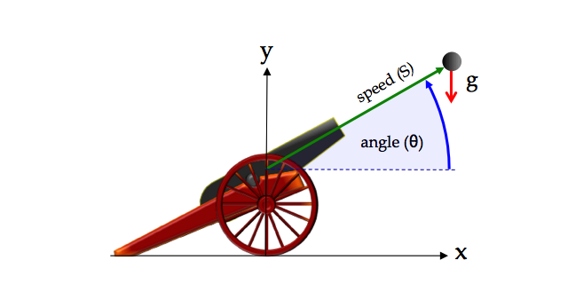
Example Dynamics Problem
Determine the trajectory, and time of impact of a cannon ball that is fired with an initial speed and initial angle. Assume a constant acceleration of gravity (g), and no aerodynamic forces.

Slide 4
Analytic Solution for Cannon Ball
Acceleration is the second-derivative of position with respect to time.
If a(t) is integratable, then we can find an analytic solution. In the case of our cannon ball problem, a(t)=g is constant, so our solution is:
(velocity- anti-derivative of acceleration)
(position- anti-derivative of velocity)
Notes:
If acceleration a(t) is integratable, then we can find an analytic solution.
In our case a=g is constant, so:

Slide 5
Initial Conditions for Cannon Ball
Speed of the cannon ball
(30°)
Angle of the barrel
Acceleration of gravity
Acceleration
The initial velocity of the cannon ball
The initial position of the cannon ball

Slide 6
Cannon Ball Time of Impact
The Ball hits the ground when:
Solving for t, using the quadratic formula:

Slide 7
A Simple (non-Trick) Simulation

Slide 8
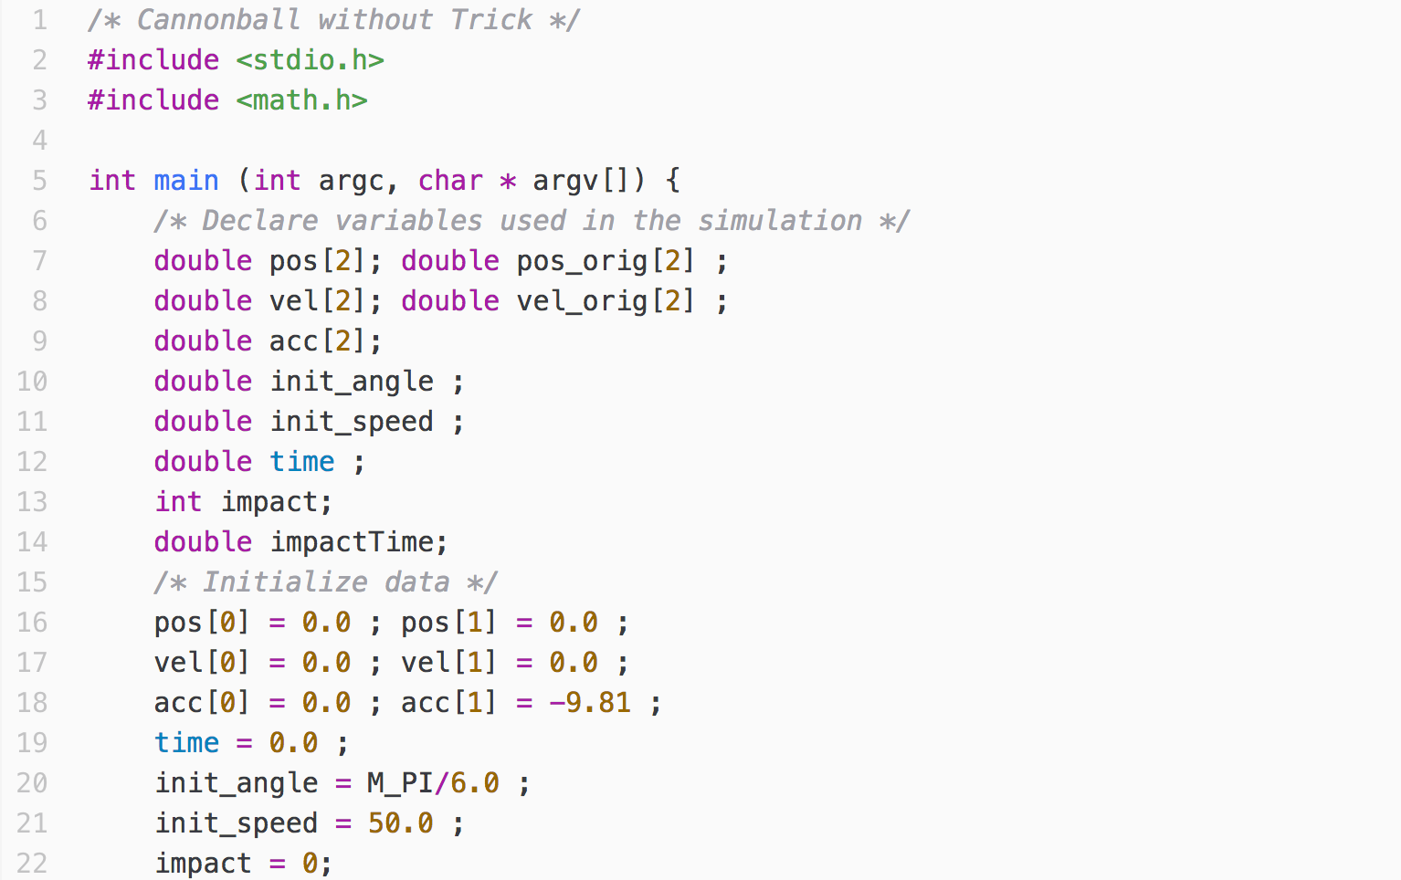
Cannon.c (page 1 of 2)
Notes:
Declare state variables, parameters
Initialize state variables, parameters

Slide 9
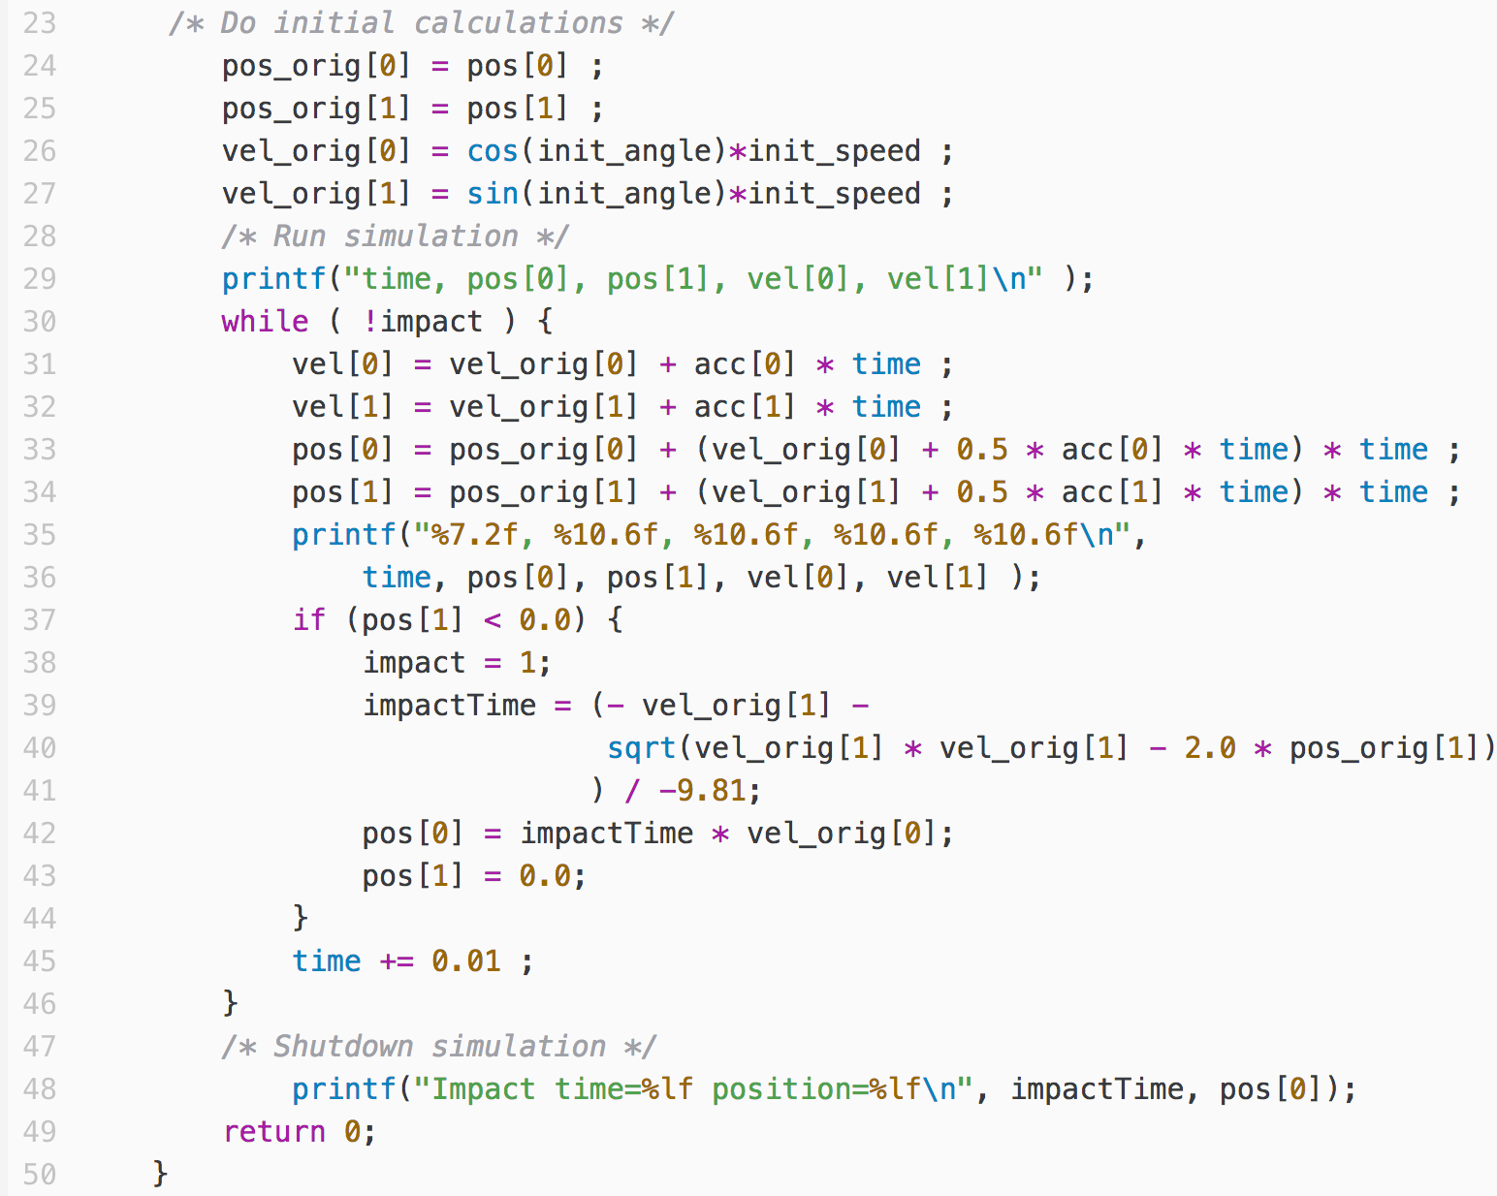
Cannon.c (page 2 of 2)
Notes:
Initial Calculations
Cycle state calculation
down

Slide 10
If we compile and run the program :
👉
% cc cannon.c -o cannon -lm
% ./cannon
We will get a listing of the trajectory points over time,
followed by the impact position and time:
Impact time=5.096840 position=220.699644

Slide 11
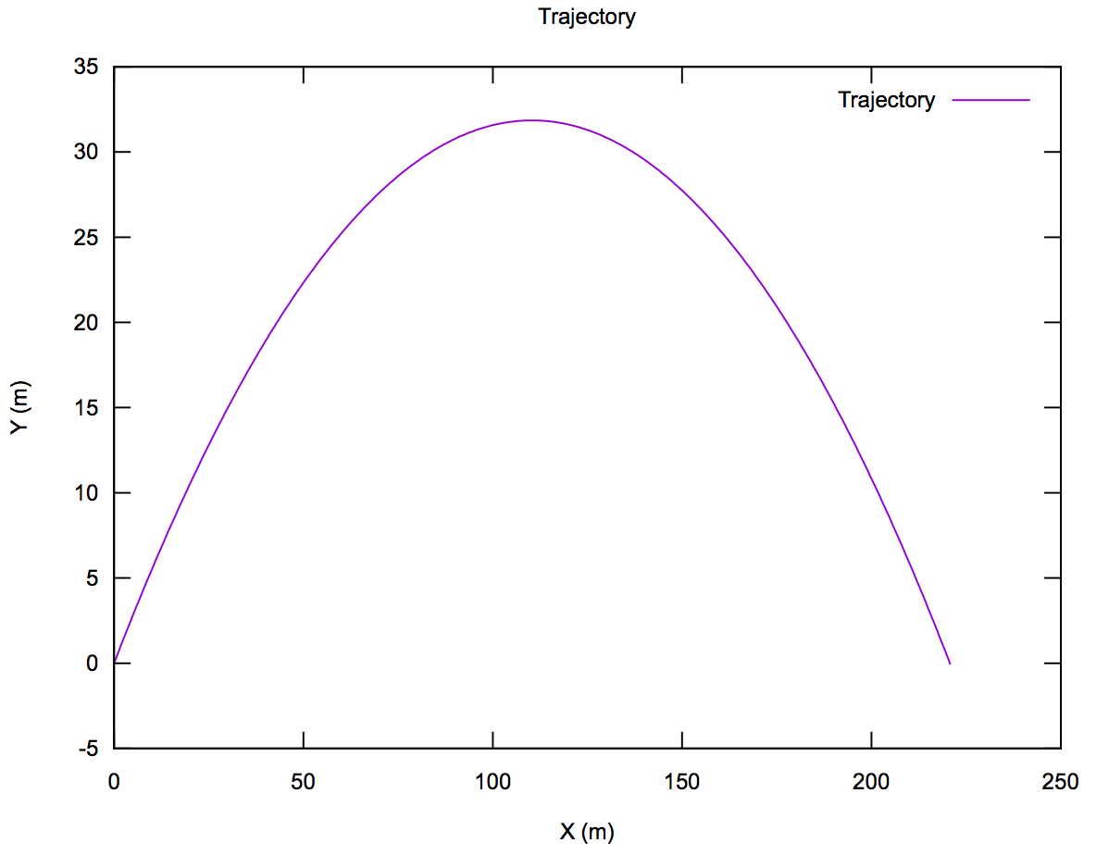
If we plot the trajectory points using Gnuplot:

Slide 12
So why do we need Trick?

Slide 13
Limitations of the Simulation
For simple physics models like our cannonball, maybe we don't need Trick, but real-world problems are rarely as simple.
Real-world problems don't often have nice closed-form solutions. They require numeric methods.
Changing parameters requires recompilation of the program.
What if we want to be able to run our simulation in real-time?
What if we want to interact with our simulation while its running?
In the coming sections, we'll see how Trick helps us overcome these limitations, and more. We’ll see how it provides simulations with commonly needed capabilites, many of them automatically.

Slide 14
The Simulation Definition File
(S_define)

Slide 15
In our non-Trick simulation program :
We created a representation of our simulation-state.
We defined our simulation-state variables.
We organized our code into well-defined tasks :
Initialization of variables by assignment
Initialization of variables by calculation.
Periodic calculation of the model state.
Cleanup/Shutdown.
We made sure that our tasks were executed in the
appropriate order.
In a Trick simulation, we do the same. To “teach” Trick about the parts that make the particular simulation unique, we use a simulation definition file (S_define).

Slide 16
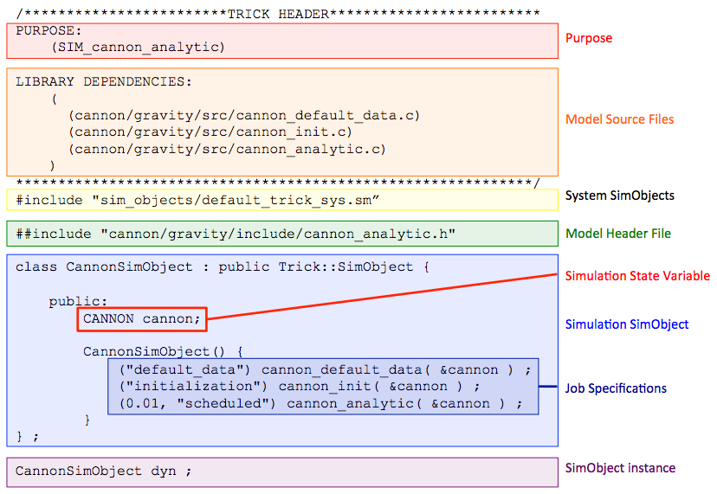
Example S_define

Slide 17
Building & Running a
Trick Simulation

Slide 18
Simulation File Organization
👉
% mkdir –p SIM_cannon_analytic/RUN_test
% mkdir –p SIM_cannon_analytic/models/cannon/src
% mkdir –p SIM_cannon_analytic/models/cannon/include
SIM_cannon_analytic/
models/
RUN_test/
cannon/
include/
src/

Slide 19
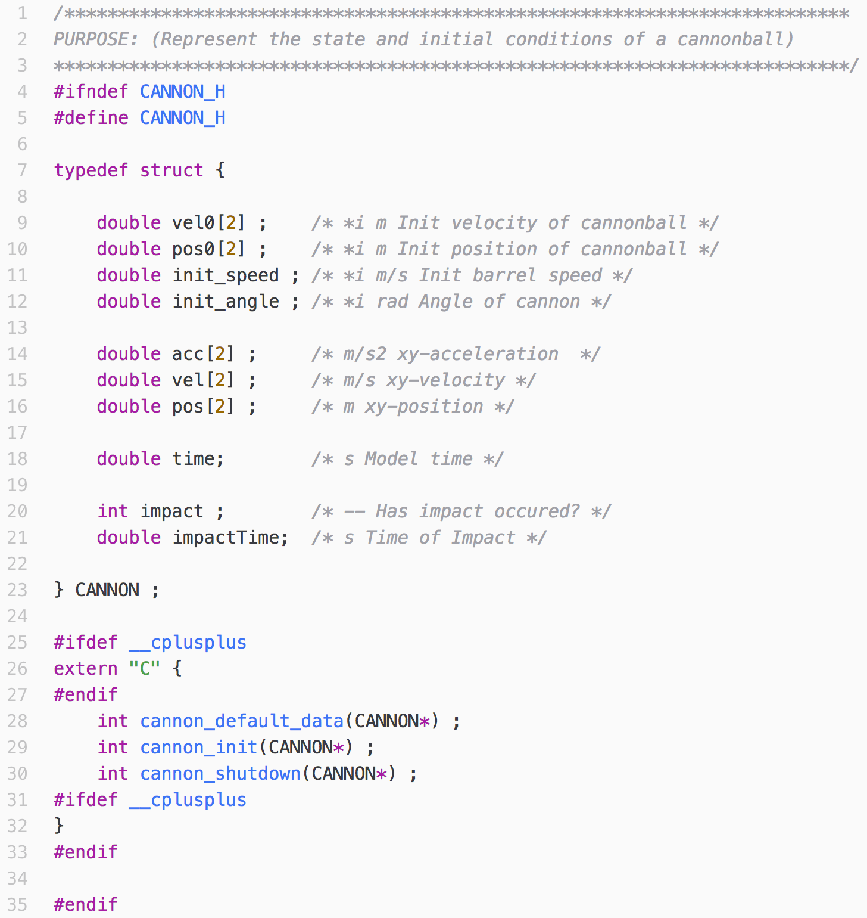
Representing the Cannonball State
cannon.h
Keyword that tells
Trick to process this file.
Specially formatted
comments for Trick.
Sim_cannon_analytic
models
Run_test
cannon
include
src

Slide 20
Trick Comments
Units specification
IO specification
Comment
double init_speed ; /* *i (m/s) Init barrel speed */

Slide 21
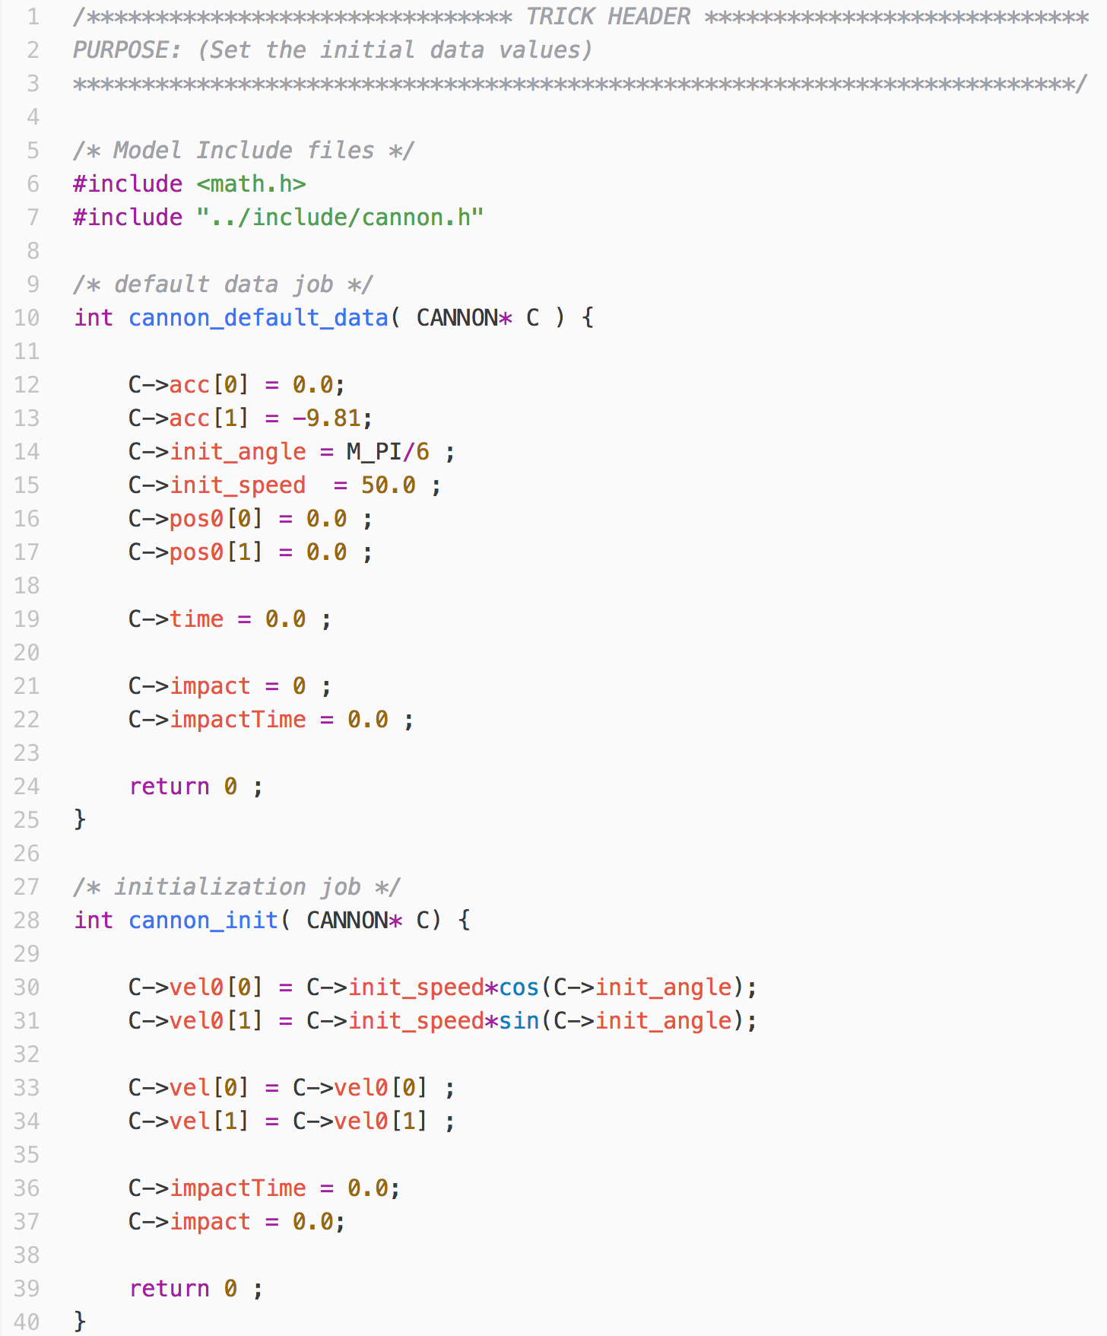
Initializing the Cannonball State
cannon_init.c
Sim_cannon_analytic
models
Run_test
cannon
include
src

Slide 22
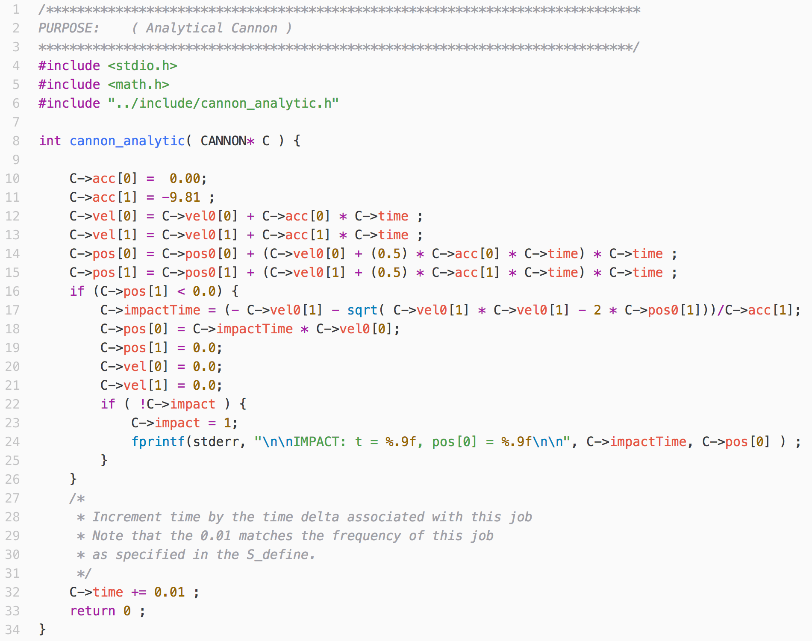
Updating the Cannonball State Over Time
cannon_analytic.c
Sim_cannon_analytic
models
Run_test
cannon
include
src
Notes:
This function will calculate the next cannon ball state.

Slide 23
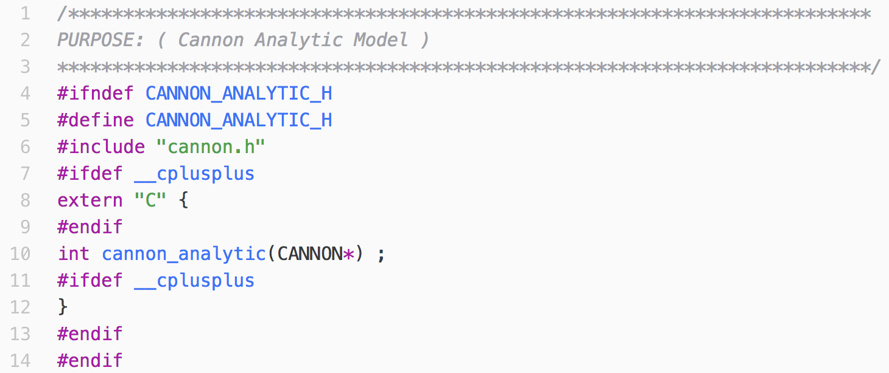
We Need a Prototype for Our State Update Approach
cannon_analytic.h
Sim_cannon_analytic
models
Run_test
cannon
include
src

Slide 24
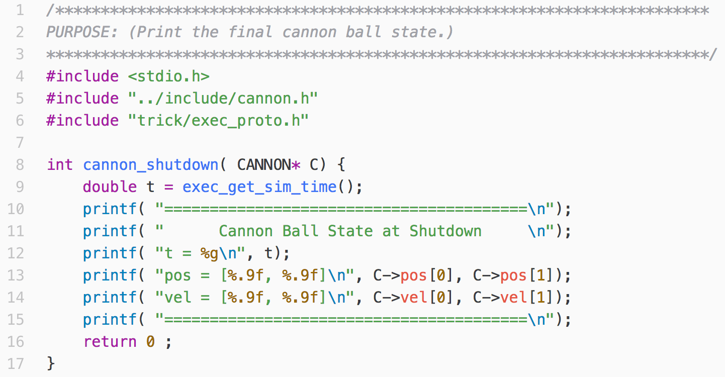
Cannonball Cleanup And Shutdown
cannon_shutdown.c
Sim_cannon_analytic
models
Run_test
cannon
include
src

Slide 25
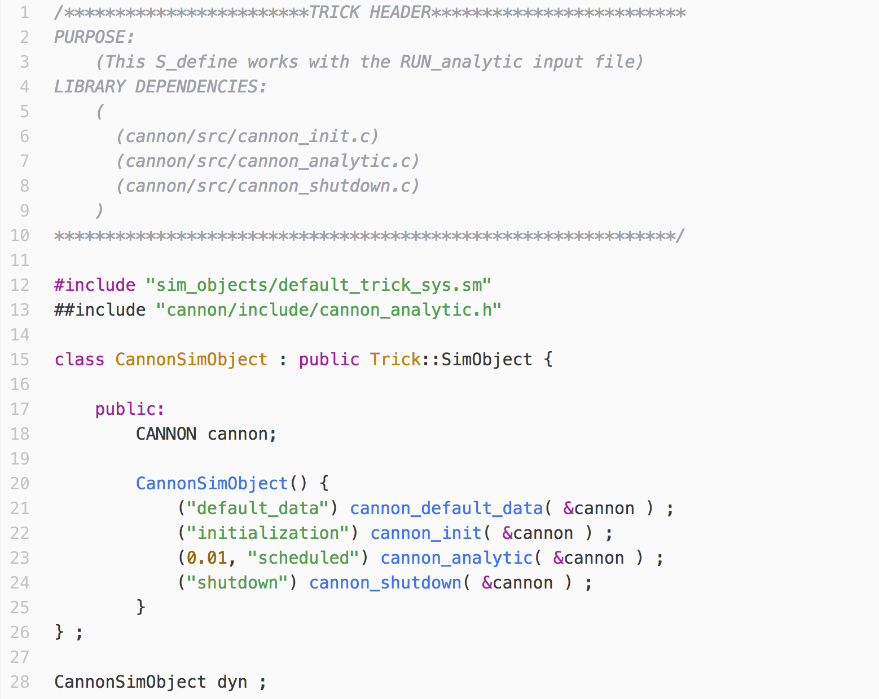
The Simulation Definition File
S_define
Trick Header
Sim_cannon_analytic
models
Run_test
Included files
cannon
include
src
Jobs
Notes:
Talk about:
The PURPOSE keyword
LIBRARY DEPENDENCIES and how the –I ‘s in TRICK_CFLAGS and TRICK_CXXFLAGS resolve relative paths.
The difference between #include and ##include
Variables: cannon
JOBS
JOB classes – There are many more.
SIMObject instance

Slide 26
Compiler Flags
S_overrides.mk
Sim_cannon_analytic
models
Run_test
cannon
include
src

Slide 27
The Importance of TRICK_CFLAGS and TRICK_CXXFLAGS
$TRICK_CFLAGS and $TRICK_CXXFLAGS are Trick environment
variables. They provide a means to control how your simulation is built.
When Trick invokes a C-compiler, it passes the value of
$TRICK_CFLAGS to it. $TRICK_CXXFLAGS are passed to C++ compilers.
For example, suppose I want the C compiler to warn me about common,
dubious code constructs that might have crept into my simulation code:
TRICK_CFLAGS += -Wall
The Trick build process also uses any -I options found in these variables to resolve relative file paths.

Slide 28
The Importance of TRICK_CFLAGS and TRICK_CXXFLAGS
The –I flag is a GNU compiler flag that lists base-paths, from which relative-paths, specified in your code, can be resolved to full-paths.
For example, the following directive specifies a relative-path:
#include “cannon/gravity/include/cannon.h”
It’s relative to some base-path that needs to be specified in order to find the file.
So, when we provide the following base-path, the compiler can resolve
the relative path.
TRICK_CFLAGS += -I${HOME}/trick_models/
Example:
Base-path
Relative-path
${HOME}/trick_models/cannon/gravity/include/cannon.h

Slide 29
The Importance of TRICK_CFLAGS and TRICK_CXXFLAGS
The –I flags in TRICK_CFLAGS and TRICK_CXXFLAGS are also used to resolve relative paths in LIBRARY DEPENDENCIES specifications in Trick headers.
LIBRARY DEPENDENCIES:
(
(cannon/src/cannon_init.c)
(cannon/src/cannon_analytic.c)
(cannon/src/cannon_shutdown.c)
)

Slide 30
Simulation File Organization
SIM_cannon_analytic/
models/
S_define
S_overrides.mk
RUN_test/
cannon/
include/
src/
cannon.h
cannon_analytic.h
cannon_analytic.c
cannon_init.c
cannon_shutdown.c
Notes:
Before we continue, lets make sure all of our files are in the right place.

Slide 31
Building the Simulation with Trick-CP
The Trick simulation build tool is called trick-CP (Trick Configuration Processor). It parses an S_define file, finding data-types, variables, functions, scheduling information, and ultimately creates a simulation executable.
After you build the sim:
👉
% cd $HOME/trick_sims/SIM_cannon_analytic
% trick-CP
you should see:
=== Simulation make complete ===

Slide 32
Simulation Input File
Every Trick simulation needs an input file. The input file is actually a script that is processed by a Python interpreter, specifically bound to Trick’s code and your simulation code.
input.py
Sim_cannon_analytic
trick.stop(5.2)
models
Run_test
cannon
include
src

Slide 33
Simulation Input File
Run the simulation executable from SIM_cannon_analytic/ :
👉
% ./S_main_*.exe RUN_test/input.py
If all goes well, something similar to the following sample output will be displayed on the terminal.
IMPACT: t = 5.096839959, pos[0] = 220.699644186
========================================
Cannon Ball State at Shutdown
t = 5.2
pos = [220.699644186, 0.000000000]
vel = [0.000000000, 0.000000000]
========================================
REALTIME SHUTDOWN STATS:
REALTIME TOTAL OVERRUNS: 0
ACTUAL INIT TIME: 0.099
ACTUAL ELAPSED TIME: 11.338
SIMULATION TERMINATED IN
PROCESS: 0
ROUTINE: Executive_loop_single_thread.cpp:98
DIAGNOSTIC: Reached termination time
SIMULATION START TIME: 0.000
SIMULATION STOP TIME: 5.200
SIMULATION ELAPSED TIME: 5.200
ACTUAL CPU TIME USED: 0.098
SIMULATION / CPU TIME: 53.268
INITIALIZATION CPU TIME: 0.052
Result

Slide 34
What about the trajectory?
To plot the trajectory, we first need to record the data from our simulation.

Slide 35
Recording Simulation Data
To tell our sim what to record, we need to create a data-recording file. Let’s first make a place to put it:
👉
% mkdir Modified_data
SIM_cannon_analytic/
Modified_data/
models/
RUN_test/
cannon/
include/
src/

Slide 36
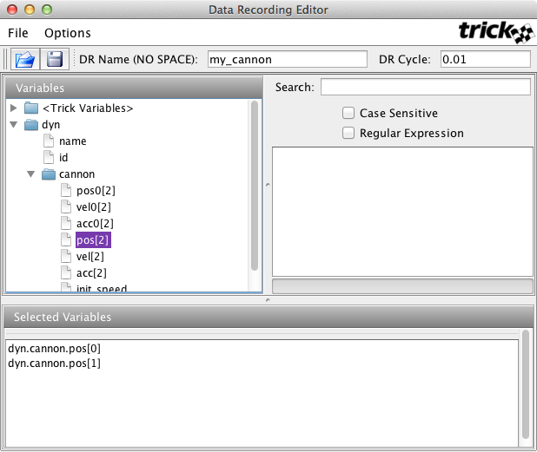
Making a Data-Recording File with trick-dre
👉
% trick-dre &
1) Give the variable collection (a.k.a “recording group”) a name.
2) Specify the recording frequency. Ok, fine, the period.
3) Double-click on the pos array (the position of the cannon ball). Note that they are then dsiplayed in the Selected variables pane.
4) Choose File->Save. In the "Save" dialog, enter the file name “cannon.dr” and save it in the Modified_data/ directory.
5) Exit trick-dre.

Slide 37
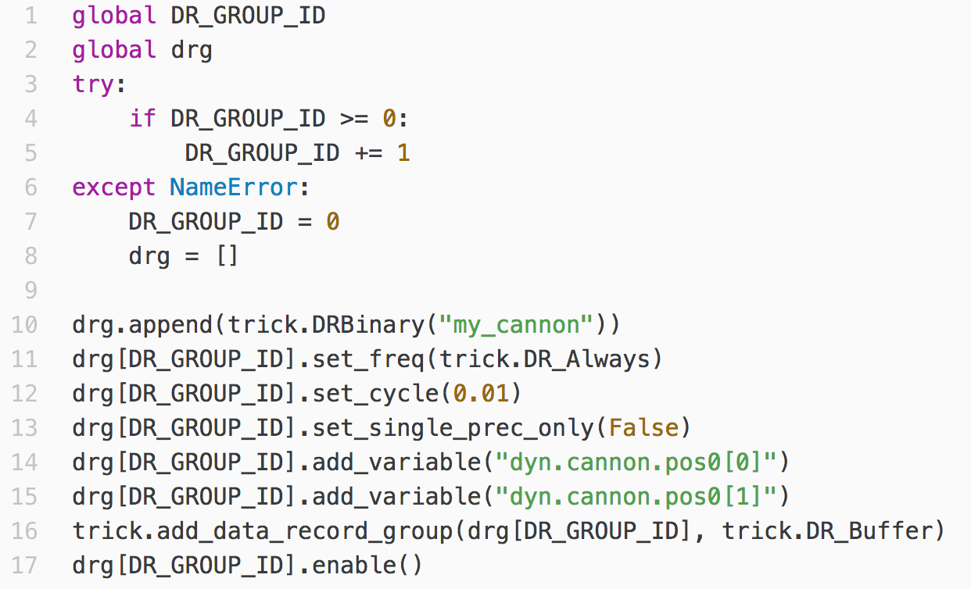
What is a Data-Recording File?
cannon.dr
DON’T TYPE THIS IN.
IT’S CREATED AUTOMATICALLY
BY trick-dre.
Sim_cannon_analytic
Modified_data
models
Run_test
cannon
include
src
A data recording file is actually a snippet of Python code that you
include into your input file.

Slide 38
Initiation of Data Recording
Update input.py
Re-run the simulation:
👉
% ./S_main*.exe RUN_test/input.py
This will produce a data recording file in your
RUN_ directory.
RUN_test/
Input.py
log_my_cannon.trk

Slide 39
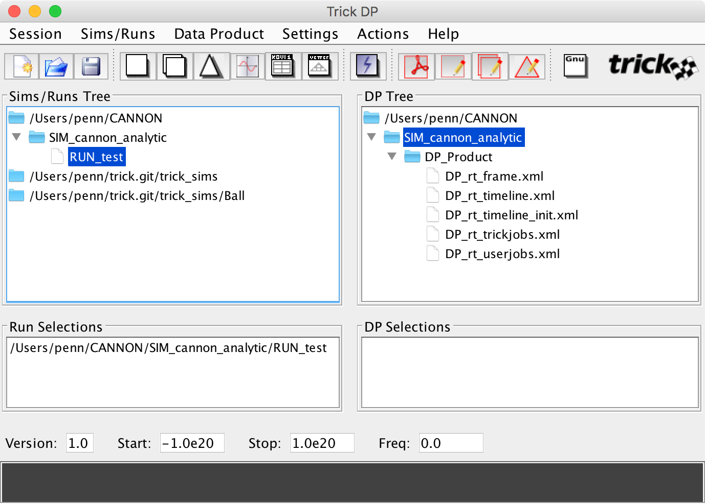
Trick Data Products
In the SIM_cannon_analytic/ directory, run trick-dp:
👉
% trick-dp &
2) Click to start trick-qp
double-click to select the recorded data.
Selected data will appear here.

Slide 40
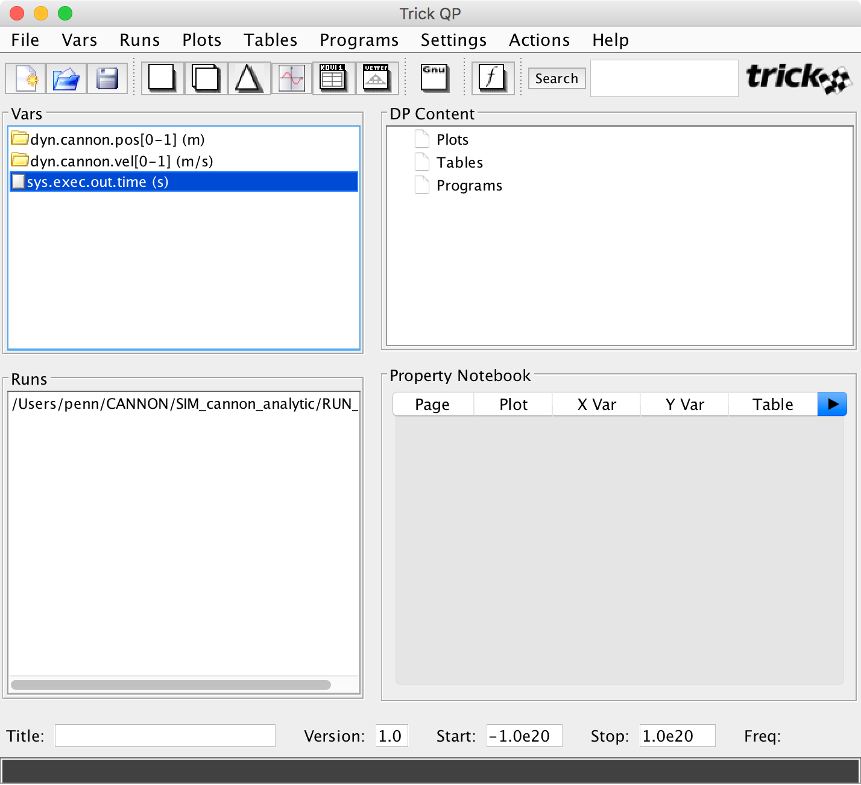
Plotting Recorded Data with trick-qp

Slide 41
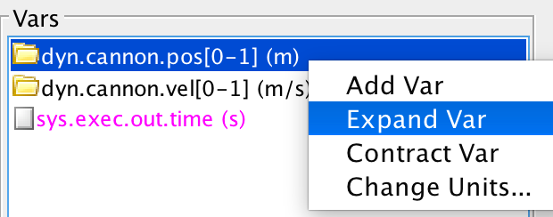
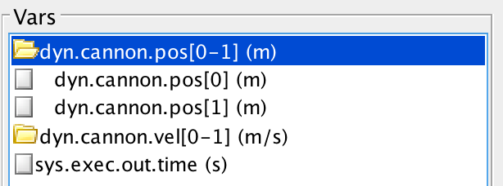
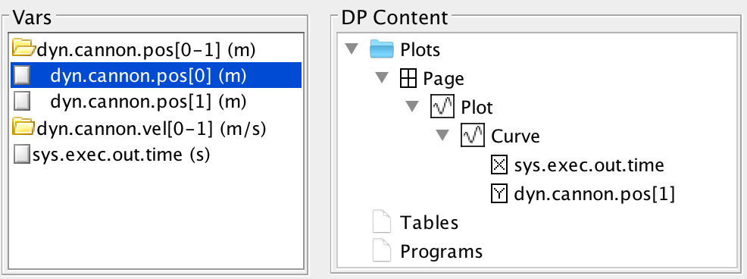
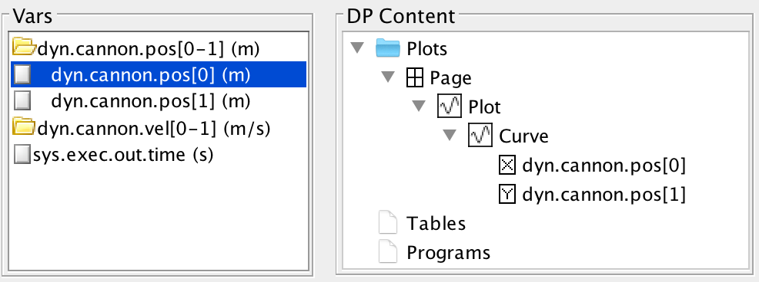
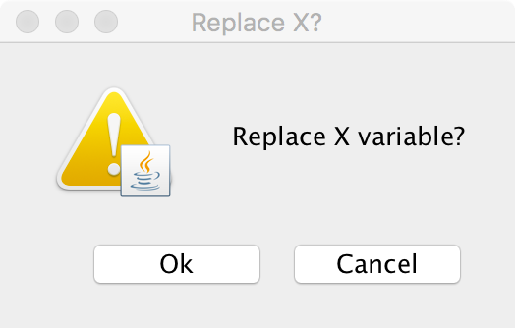

Telling trick-qp What to Plot
Click and drag dyn.cannon.pos[0] with left mouse
button to the curves X coordinate.
Click and drag from here to here.
Click the Single Plot Button.

Slide 42
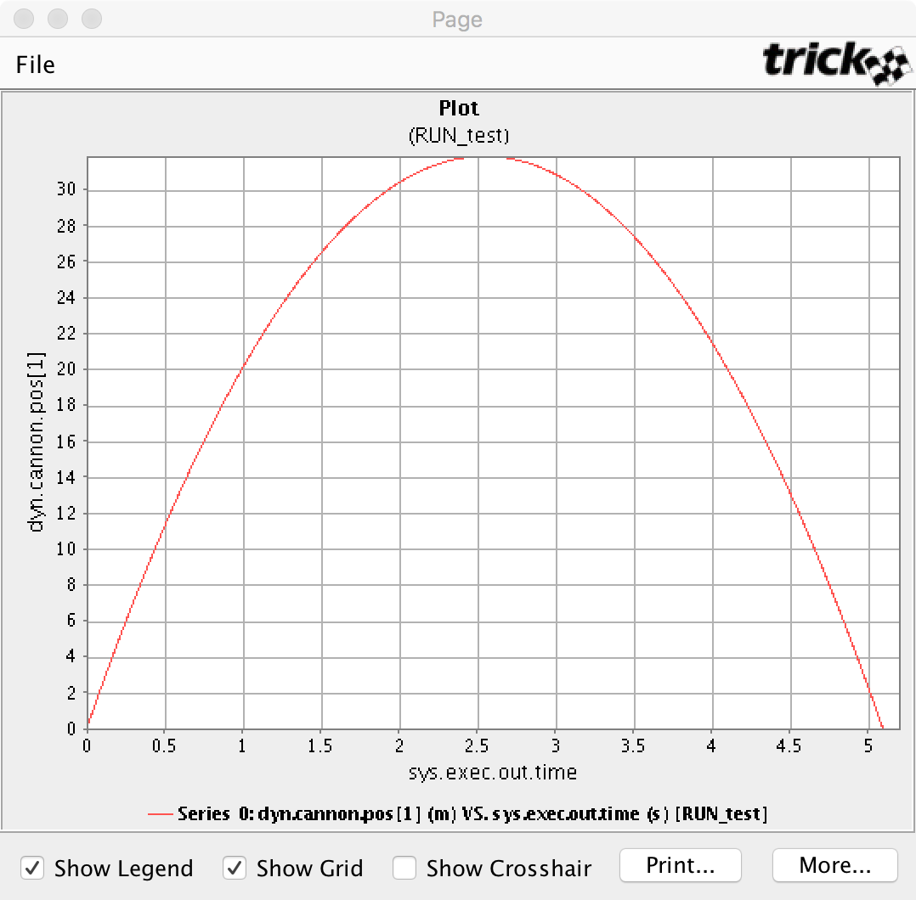
Plotting Recorded Data

Slide 43
Running Real-time

Slide 44
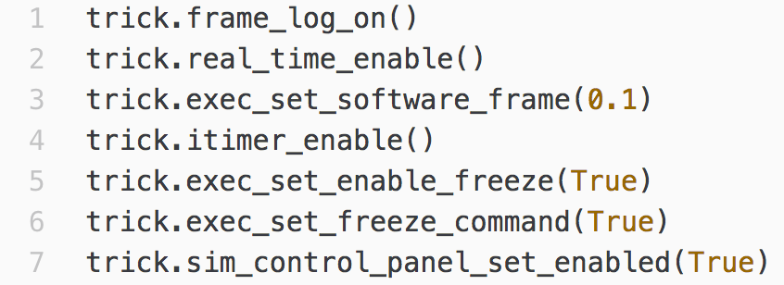
Recall that the cannonball run was 5.2 seconds, yet when the simulation ran, it was done in a flash. This section will add real-time synchronization.
realtime.py
Sim_cannon_analytic
Modified_data
models
Run_test
cannon
include
src

Slide 45
Specifying Real-time Operation
trick.real_time_enable()
Enables Trick real-time. In other words, it enables the periodic synchronization of simulation-time with real-time (“wall-clock-time”).
trick.exec_set_software_frame(0.1)
Specifies how often simulation-time is synchronized with real-time.

Slide 46
Once You’re in Real-time
trick.itimer_enable()
Allows other processes to run while Trick is waiting for the beginning of the next software frame to start the simulation jobs. If interval timers are not used, Trick will spin waiting for the next beat.
trick.exec_set_freeze_command()
Puts the simulation in freeze mode at start-up
trick.exec_set_enable_freeze()
Allows a user to toggle the simulation mode between FREEZE and RUN.
trick.sim_control_panel_set_enabled(True)
Starts the sim control panel GUI.
trick.frame_log_on()
Log simulation performance data.

Slide 47
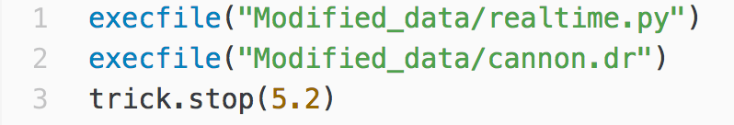
Running in Real-time
Update input.py
Re-run the simulation:
👉
% ./S_main*.exe RUN_test/input.py

Slide 48
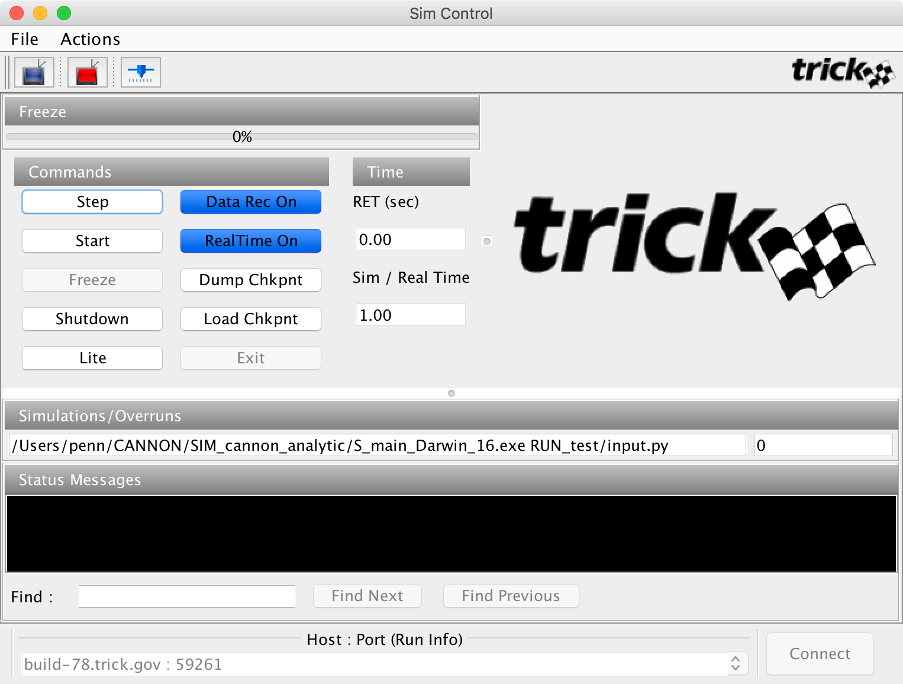

Sim Control Panel
Trick View
Simulation Mode
Click here to RUN the sim.
Simulation
Executable
Overrun count
Variable
Server Port

Slide 49
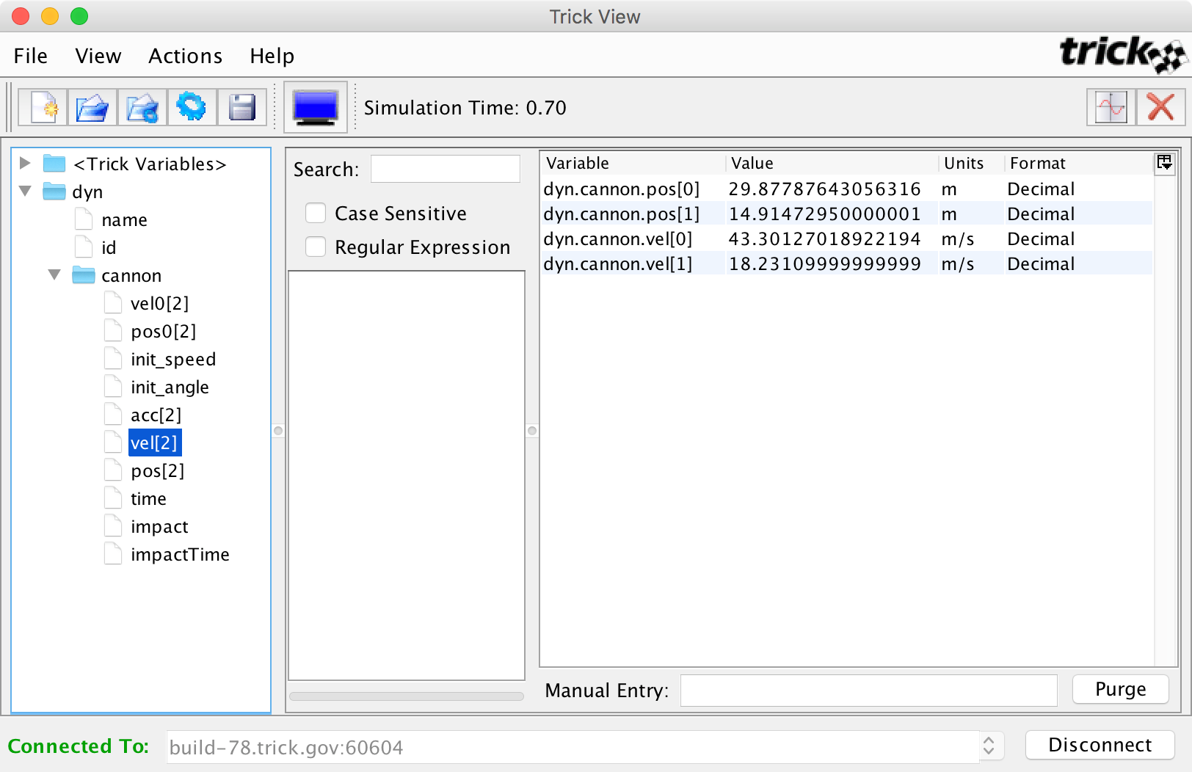
Trick View (TV)
Double-click to edit values
Left-click
to change units
Double-click
variables to select for viewing

Slide 50
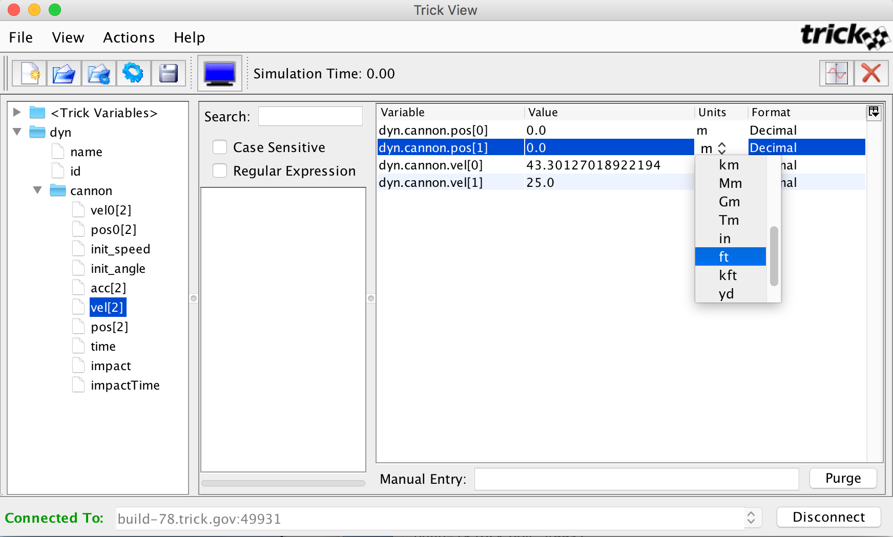
Trick View (TV)

Slide 51
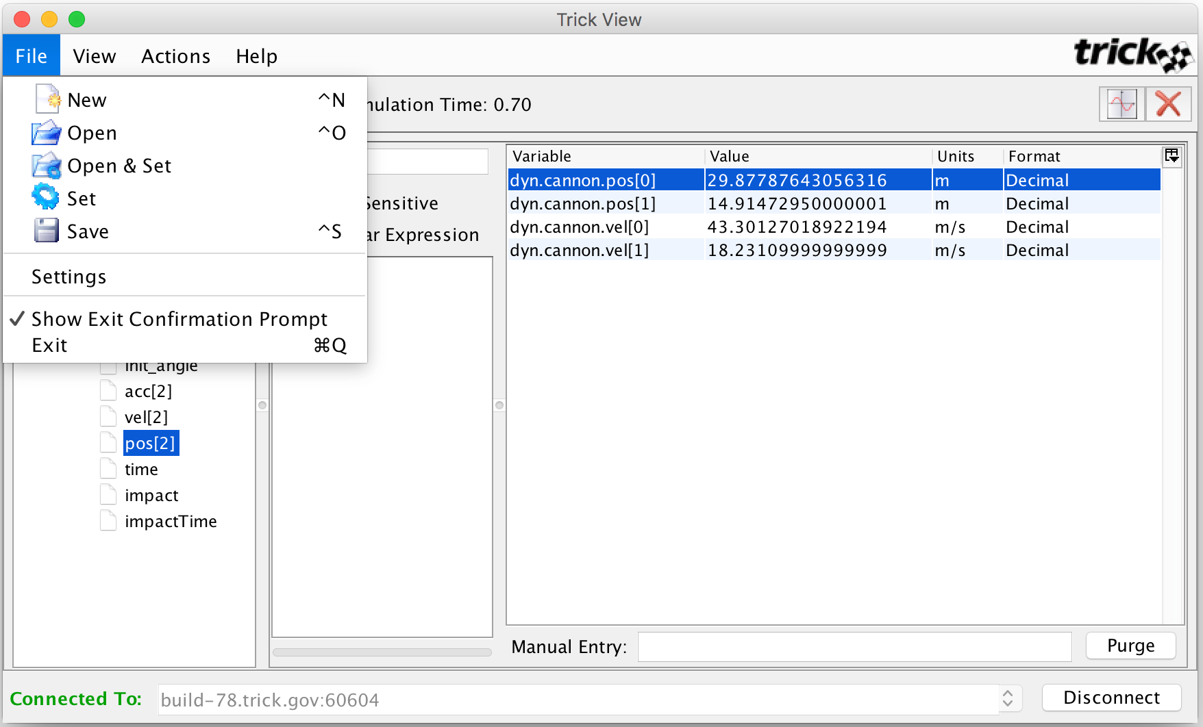

Trick View (TV)

Slide 52
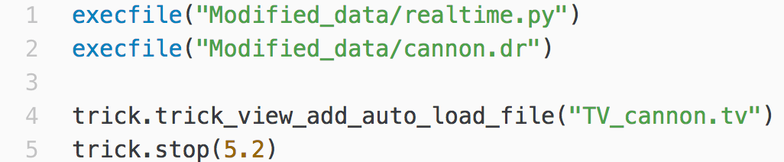
Trick View (TV)
Update input.py
Re-run the simulation:
👉
% ./S_main*.exe RUN_test/input.py
The sim will come up as before, but Trick View will also come up
With the previously saved variable set.

Slide 53
State Propagation with
Numerical Methods

Slide 54
When Analytic Solutions Don’t Exist
The simulation we’ve thus far created, relies on the fact that the cannon ball problem has an closed-form solution. From it, we can immediately calculate the cannon ball state (position, and velocity) at any arbitrary time. In real-world simulation problems, this will rarely be the case.
In this section, we’re going to pretend that no analytic solution exists and model the cannon ball using numeric-integration.
Notes:
NOTE: “closed-form” and “analytic” solutions are the same thing.

Slide 55
Updating the Cannon Ball Sim to Use Numerical Integration
Rather than type everything again, we will first "tidy up" and copy the simulation. Then we’ll modify it to use numeric integration.
To tidy up, execute the following:
👉
% cd $HOME/trick_sims/SIM_cannon_analytic
% make spotless
Copy the sim directory, giving it a new name.
👉
% cd ..
% cp -r SIM_cannon_analytic SIM_cannon_numeric
Notes:
Elaborate on “make spotless”

Slide 56
Job Classes for Numerical Integration
To provide simulation developers with a means of getting data into and out of these algorithms, Trick defines the following two job classes:
derivative class jobs - for calculating the state time derivatives.
integration class jobs - for integrating the state time derivatives from time t_{n-1} to t_{n}, to produce the next state.
A special integ_loop job scheduler coordinates the calls to these jobs derivative and integration jobs.

Slide 57
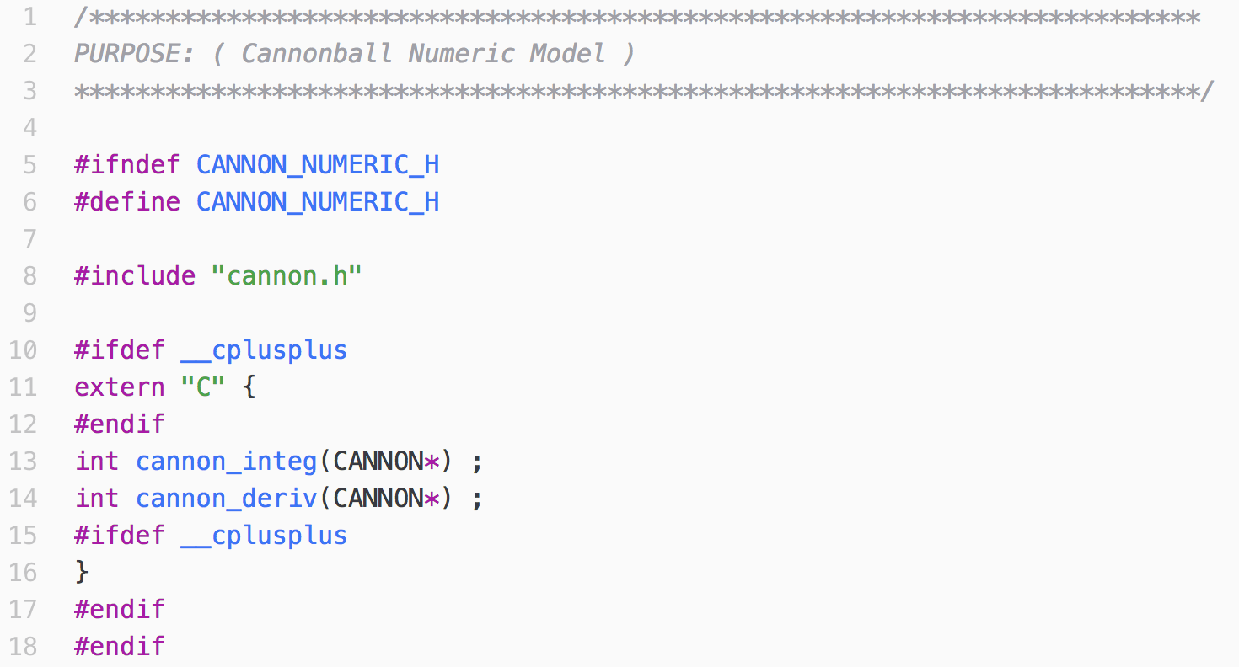
Interface Specifically for Numeric Job Functions
cannon_numeric.h
Sim_cannon_numeric
models
Run_test
cannon
include
src

Slide 58
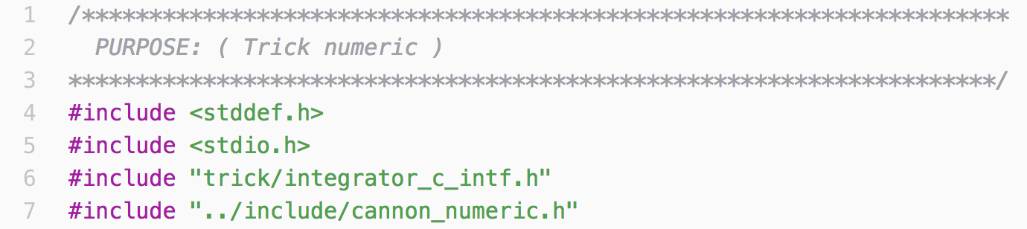
Start of Cannonball Numeric Approach
cannon_numeric.c
Sim_cannon_numeric
models
Run_test
cannon
include
src
👉
Add the code snippet above to cannon_numeric.c
To this, we’ll be soon our derivative and integration job functions.

Slide 59
Derivative Class Jobs
The purpose of a derivative class job is to generate a model’s time-derivatives, that is, it evaluates the right-hand side of the model’s differential equation.
For "F=ma" type models, derivative jobs calculate acceleration, by dividing force by mass.
All time dependent quantities from which acceleration is calculated should also be calculated in the derivative job.
In the corresponding integration class job, the acceleration is then integrated to produce velocity, and velocity is integrated to produce position.

Slide 60
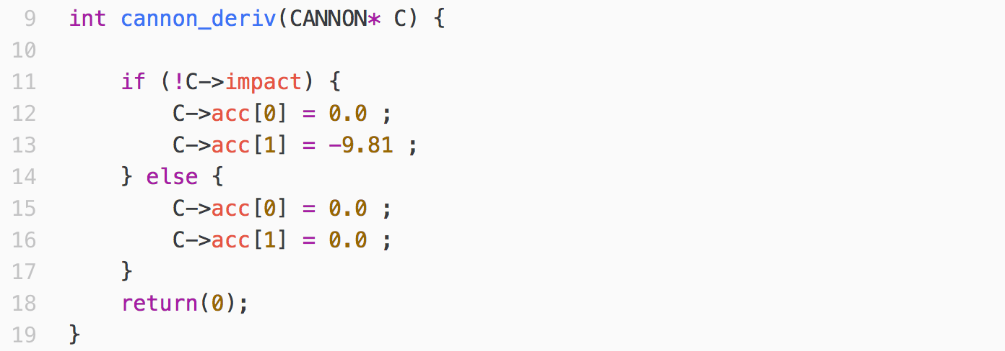
Cannon Ball Derivative Job-function
Sim_cannon_numeric
models
Run_test
cannon
👉
Add cannon_deriv() to cannon_numeric.c
include
src
Notes:
Since our acceleration is constant our derivative job is very simple.

Slide 61
Integration Class Jobs
The purpose of a integration class job is to integrate the derivatives that were calculated in the corresponding derivative jobs, producing the next simulation state from the previous state.
Integration jobs generally look very similar. That is because they are expected to do the same five things:
Load the state into the integrator.
Load the state derivatives into the integrator.
Call the integrate() function.
Unload the updated state from the integrator.
Return the value that was returned by the integrate() call.

Slide 62
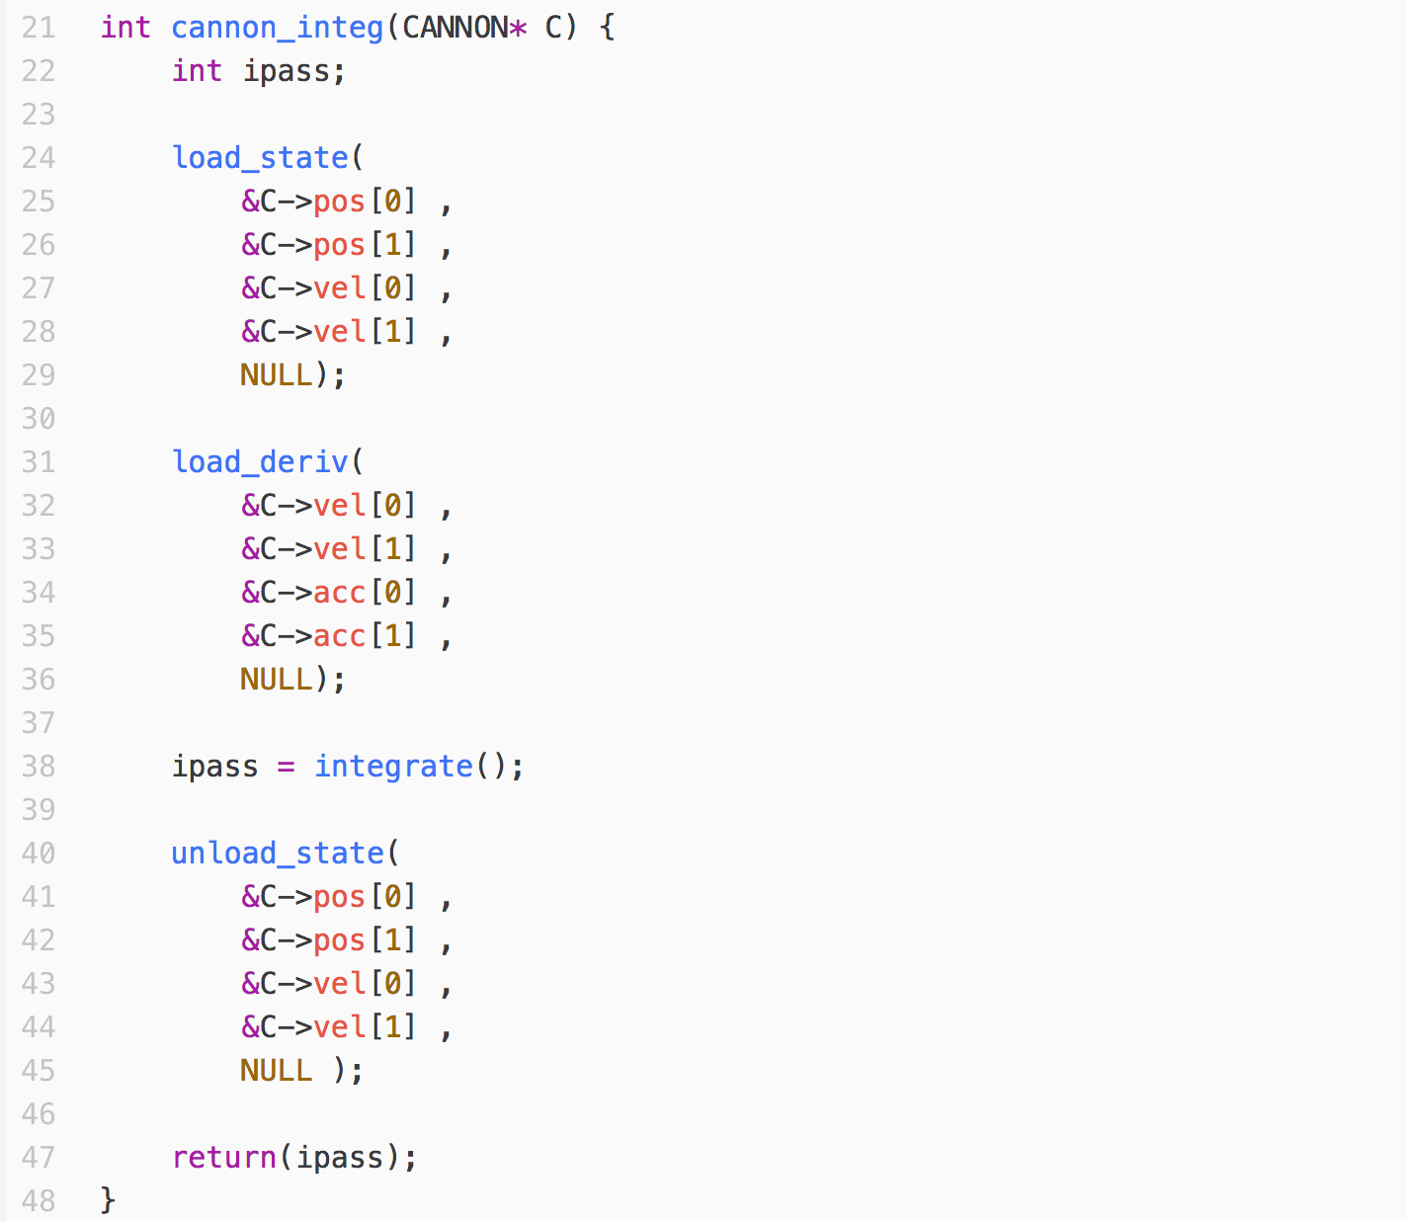
Cannon Ball Integration Job-function
cannon_integ.c
Sim_cannon_numeric
models
Run_test
cannon
include
src
👉
Add cannon_integ() to cannon_numeric.c

Slide 63
Updating the S_define File
👉
Update the LIBRARY_DEPENDENCY section:
REPLACE:
(cannon/src/cannon_analytic.c)
WITH:
(cannon/src/cannon_numeric.c)
👉
Update ##includes
Sim_cannon_numeric
REPLACE:
##include "cannon/include/cannon_analytic.h"
models
Run_test
WITH:
##include "cannon/include/cannon_numeric.h"
cannon
👉
Update Scheduled Jobs
include
src
REPLACE:
(0.01, "scheduled") cannon_analytic( &cannon ) ;
WITH:
("derivative") cannon_deriv( &cannon) ;
("integration") trick_ret= cannon_integ( & cannon);
And one more thing …

Slide 64
Integration Loop Configuration
Producing simulation states by numerical integration requires that derivative and integration jobs be called at the appropriate rate and times. This requires a properly configured integration- scheduler. This is a two part process:
Create an integration-scheduler.
Select an integration algorithm for that scheduler.

Slide 65
Creating an Integration Scheduler
An integration scheduler is instantiated in the S_define. It takes the form:
IntegLoop integLoopName ( integrationTimeStep ) listOfSimObjectNames ;
Jobs within named simObjects that are tagged “derivative" or "integration” will be dispatched by the associated integration scheduler.

Slide 66
Selecting an Integrator
In the input file, call the IntegLoop getIntegrator() method to specify the integration algorithm of choice and the number of state variables to be integrated.
integLoopName.getIntegrator( algorithm, N );
algorithm is an enumeration value that indicates which numerical integration algorithm to use, such as: trick.Euler, trick.Runge_Kutta_2, trick.Runge_Kutta_4, etc*.
N is the number of state variables to be integrated.
* A complete list of available algorithms can be seen Integrator.hh, in ${TRICK_HOME}/include/trick/Integrator.hh .

Slide 67
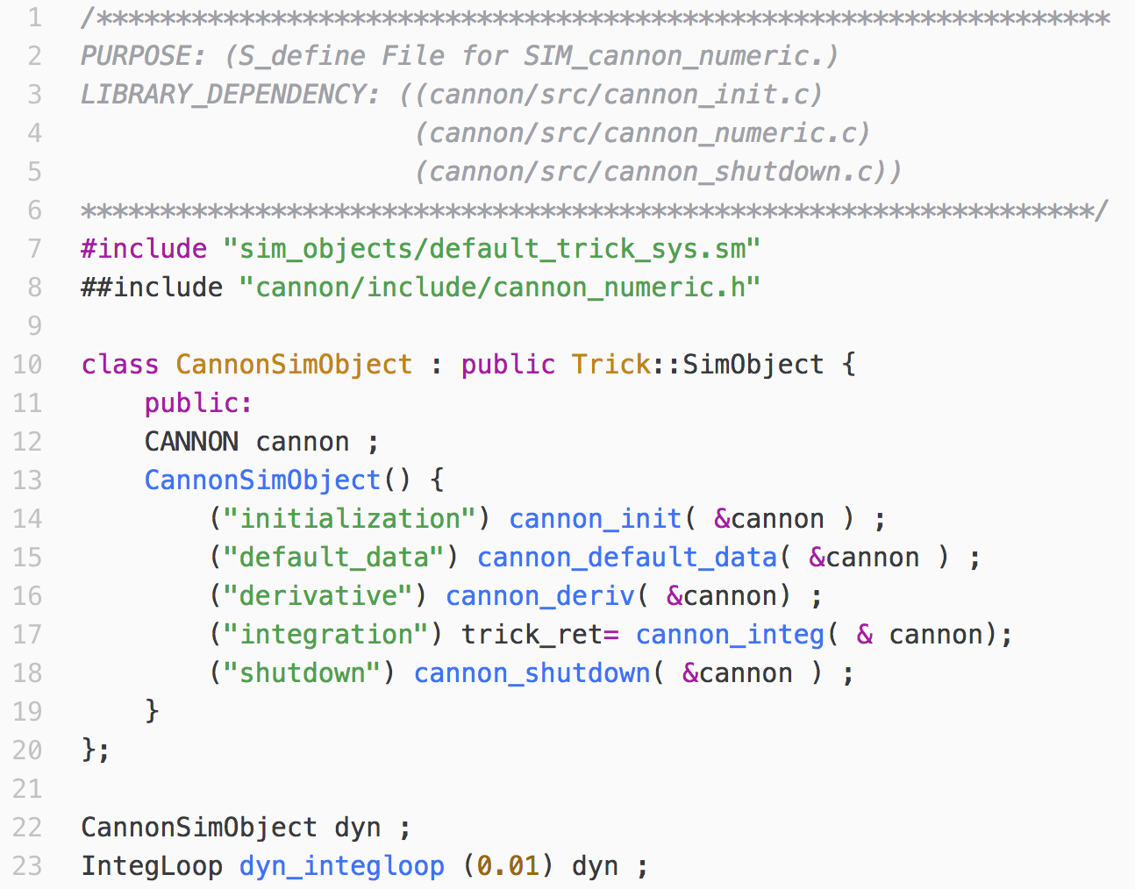
S_define for Numeric Sim
S_define
NEW
NEW
NEW
NEW
Notes:
Discuss the four updates:
LIBRARY DEPENDENCIES
##includes
Derivative and integration jobs
Integloop
trick-ret is returned to the scheduler to it when the integration step is complete.

Slide 68
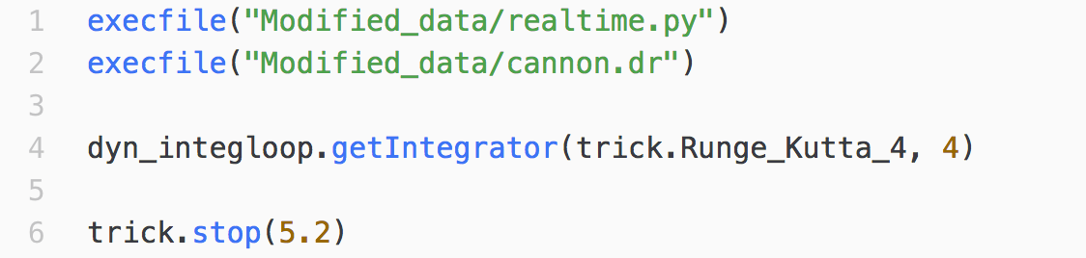
Input File for Numeric Sim
input.py
Sim_cannon_numeric
models
Run_test
cannon
include
src
👉
Update input.py as shown.
NEW
Notes:
Discuss the integloop.
Note that the number of state variables is 4.
Indicating four state variables ( pos[0], pos[1], vel[0], vel[1] )
and four state-derivative variables ( vel[0], vel[1], acc[0], acc[1] ).

Slide 69
Running the Numeric Sim
👉
% cd $HOME/trick_sims/SIM_cannon_numeric
% trick-CP
👉
% ./S_main*.exe RUN_test/input.py
We get:
========================================
Cannon Ball State at Shutdown
t = 5.2
pos = [225.166604984, -2.631200000]
vel = [43.301270189, -26.012000000]
========================================
DON’T PANIC!
It’s not the same. That’s because didn’t stop our sim at impact-time. We will.

Slide 70
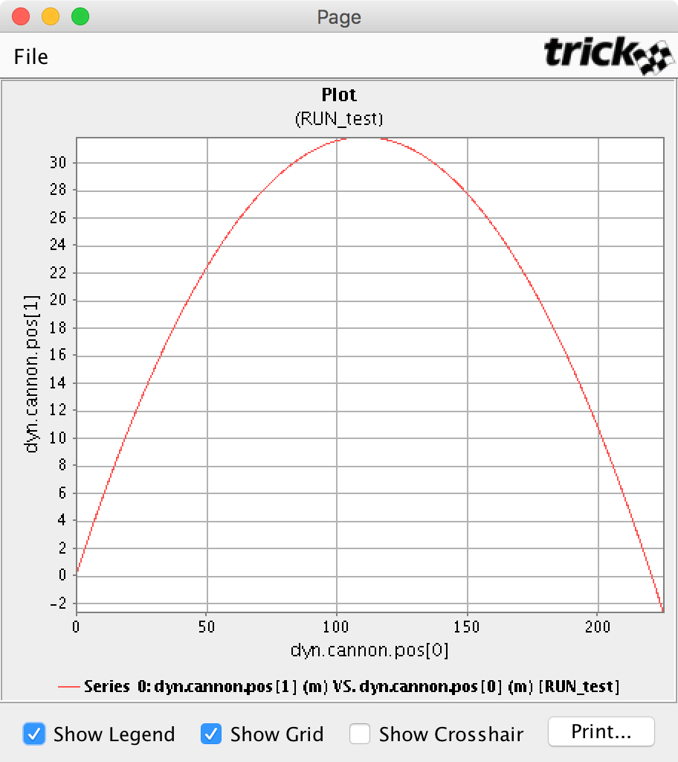
Running the Numeric Sim
In our analytic sim, we stopped updating our cannonball state at impact, when we crossed y=0, at t=5.096839.
In our numeric sim, didn’t detect impact, and continued to update the cannonball state until t = 5.2.

Slide 71
So, what about the impact-time?
Remember, we’re pretending that we don’t have an analytical solution. So, we can’t use our time-of-impact equation.

Slide 72
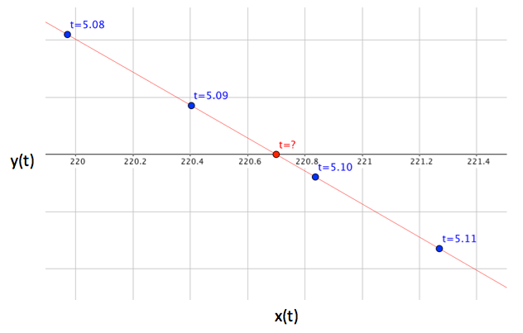
Dynamic Events
We need a numerical method to determine the precise time of impact, t when y(t)=0.
trajectory
In Trick, we call this type of occurrence, when our simulation state is at some boundary that we've defined, a dynamic-event. To find dynamic-events, we use dynamic-event jobs.

Slide 73
Dynamic Event Jobs
The job scheduler calls dynamic-event jobs, after each integration step:
To detect when the simulation state crosses a user-defined event boundary,
To take control of integration, to find the exact event-state and time, and
To perform some action as a result of finding the event-state.
It does this using the Trick's regula_falsi() function and REGULA_FALSI data-type to implement the False Position Method.

Slide 74
Finding Events with regula_falsi()
The regula_falsi() function is the heart of a dynamic event function. It's job is to:
Monitor the simulation state produced by each integration step,
Detect when the state crosses a specified event boundary, and
Guide Trick's integration scheduler to find that event.
Progress toward finding the event state is recorded in a REGULA_FALSI variable.

Slide 75
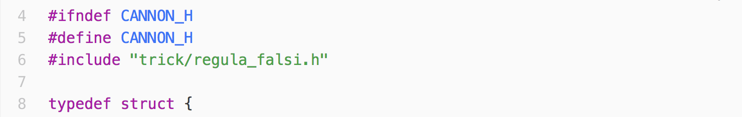
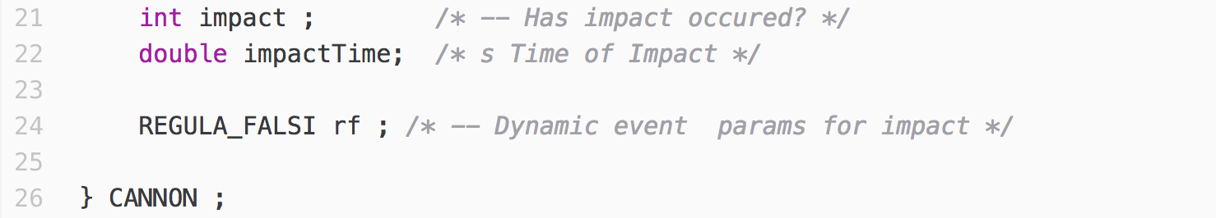
Updates to cannon.h
NEW
NEW
👉
Update cannon.h as shown.

Slide 76
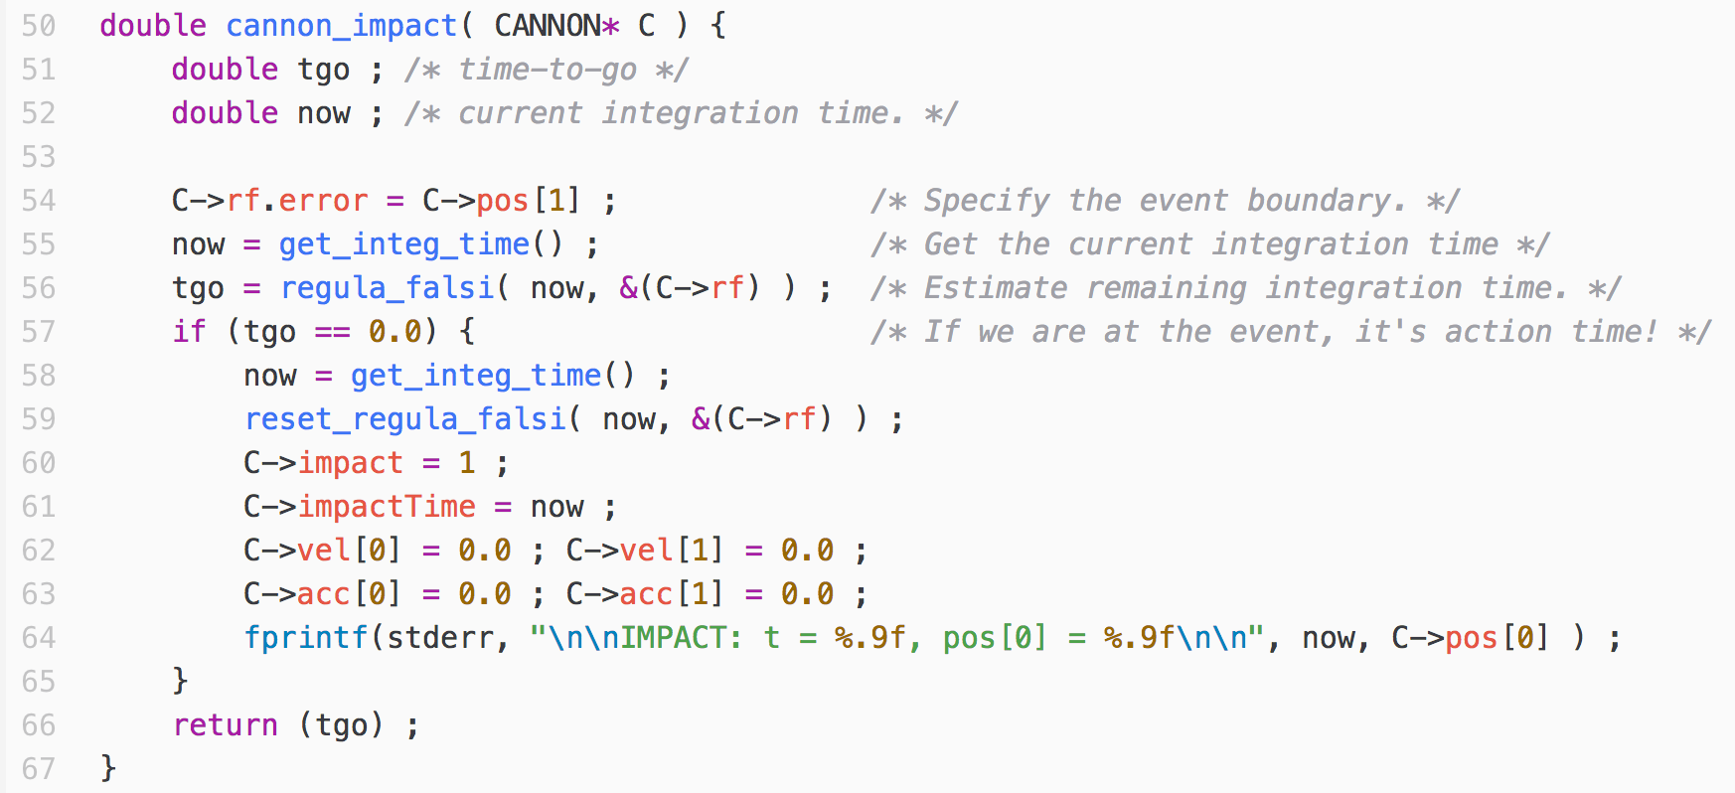
Dynamic Event Job Function: cannon_impact()
👉
Add this function, to the bottom of cannon_numeric.c

Slide 77
Specifying an Event Boundary – REGULA_FALSI.error
REGULA_FALSI.error – how far and on which side of the boundary
is the cannon ball. We set rf.error to the y-coordinate of the ball.
t=5.10
REGULA_FALSI.error > 0
+
y=0
-
Boundary
220.4
220.6
REGULA_FALSI.error < 0
t=5.10

Slide 78
Specifying an Event Boundary – REGULA_FALSI.mode
REGULA_FALSI.mode – enumeration value that constrains an event
to a particular direction of boundary crossing.
Increasing - specifies that an event occurs only when the boundary is crossed from negative to positive.
Decreasing - specifies that an event occurs only when the boundary is crossed from positive to negative.
Any - (default) specifies that an event occurs when the boundary is crossed from either direction.

Slide 79
Calling regula_falsi()
The regula_falsi function estimates the amount of time until REGULA_FALSI.error reaches 0, that is, when the boundary will be crossed.
double regula_falsi( currentIntegrationTime, regulaFalsi_p );
currentIntegrationTime – from get_integ_time()
regulaFalsi_p – pointer to REGULA_FALSI object.
Returns – an estimate of the amount of time until the event.

Slide 80
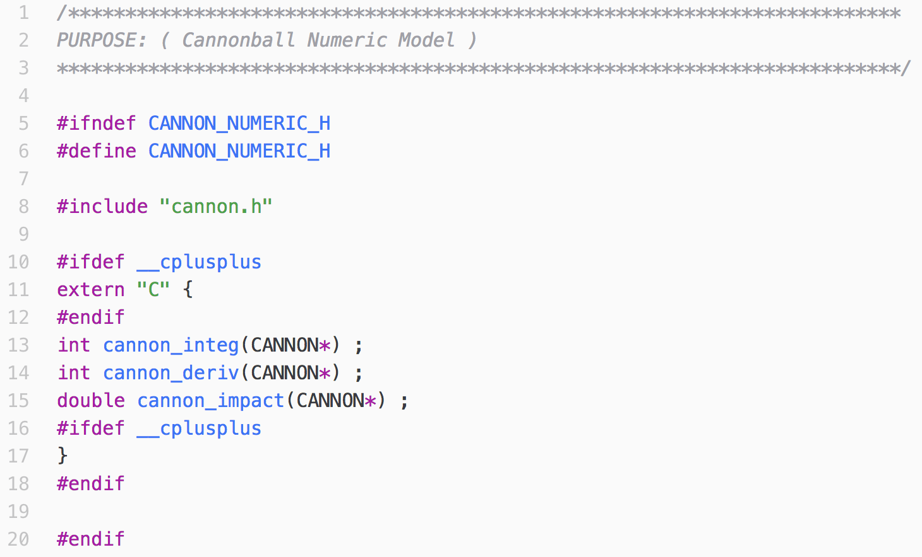
Update cannon_numeric.h
NEW

Slide 81
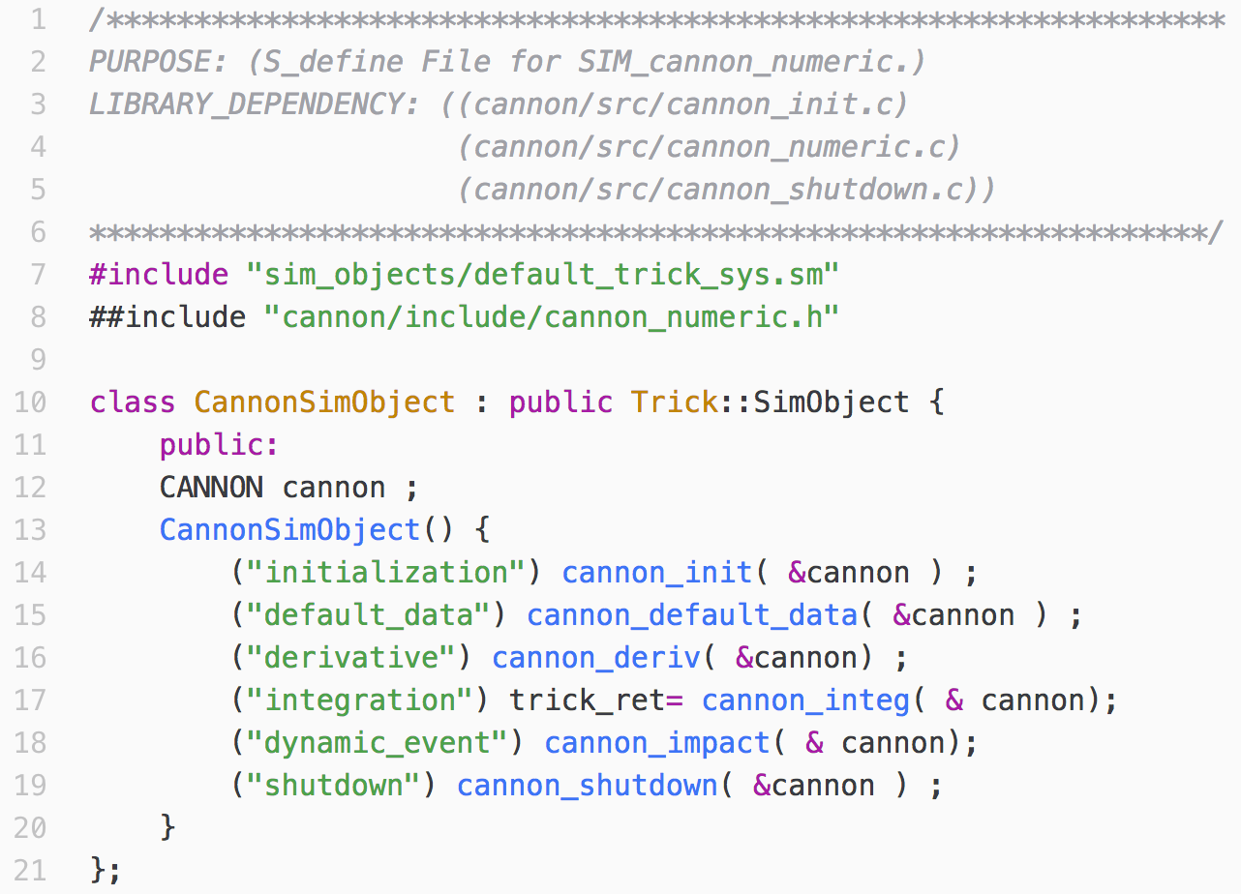
Update S_define for Numeric Sim
NEW

Slide 82
Running the Completed Numeric Sim
👉
Rebuild SIM_Cannon_numeric.
👉
Run it.
We get:
IMPACT: t = 5.096839959, pos[0] = 220.699644186
========================================
Cannon Ball State at Shutdown
t = 5.2
pos = [220.699644186, 0.000000000]
vel = [0.000000000, 0.000000000]
========================================
The same answer we got with our analytic sim!

Slide 83
Congratulations!
You’ve completed the Basic Trick Tutorial Review!

